Slide 1
WELCOME TO THE PRESENTATION

Slide 2
PRESENTATION ON LOGIC OPERATOR
PRESENTED BY
Mohammad Ashraful Islam ; ID: 15162103013 ; SEC: 01 ; INTAKE: 32ND
Salahuddin Gazi Fahim ; ID: 15162103019 ; SEC: 01 ; INTAKE: 32ND
Dween Mohammad ; ID: 15162103038 ; SEC: 01 ; INTAKE: 32ND
DEPARTMENT OF B.Sc. in CSE
FACULTY OF ENGINEERING & APPLIED SCIENCES
BANGLADESH UNIVERSITY OF BUSINESS AND TECHNOLOGY

Slide 3
index
LOGIC GATES
LOGICAL SYMBOL AND TRUTH TABLE OF LOGIC GATES
ABOUT THE PROJECT
FLOW CHART
TOPICS THAT IT (PROJECT) WILL COVER
WORKING PROCEDURE

Slide 4
Logic Gates
Logic gates are the basic building blocks of any digital system.
It is an electronic circuit having one or more than one input and only one output.
The relationship between the input and the output is based on a certain logic.
Based on this, logic gates are named as AND gate, OR gate, NOT gate etc.

Slide 5


Logical symbol and truth table of logic gates
Logical Symbol For AND GATE
Truth Table For AND GATE
X | Y | Z
0 | 0 | 0
0 | 1 | 0
1 | 0 | 0
1 | 1 | 1
Logical Symbol For OR GATE
Truth Table For OR GATE
X | Y | Z
0 | 0 | 0
0 | 1 | 1
1 | 0 | 1
1 | 1 | 1

Slide 6


Continue…..
Logical Symbol For NAND GATE
Truth Table For NAND GATE
X | Y | Z
0 | 0 | 1
0 | 1 | 1
1 | 0 | 1
1 | 1 | 0
Logical Symbol For NOR GATE
Truth Table For NOR GATE
X | Y | Z
0 | 0 | 1
0 | 1 | 0
1 | 0 | 0
1 | 1 | 0

Slide 7
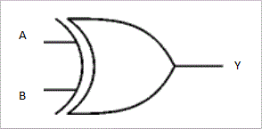
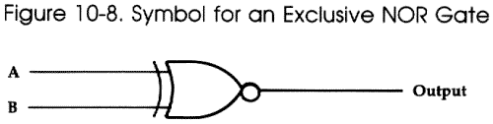
Continue…..
Logical Symbol For XOR GATE
Truth Table For XOR GATE
X | Y | Z
0 | 0 | 0
0 | 1 | 1
1 | 0 | 1
1 | 1 | 0
Logical Symbol For XNOR GATE
Truth Table For XNOR GATE
X | Y | Z
0 | 0 | 1
0 | 1 | 0
1 | 0 | 0
1 | 1 | 1

Slide 8
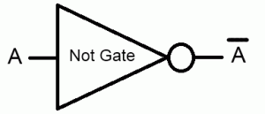
Continue…..
Logical Symbol For NOT GATE
Truth Table For NOT GATE
X | Z
0 | 1
1 | 0

Slide 9
About the project
This project will work on logic gates operation (AND, OR, NAND, NOR, EX_OR, EX_NOR, NOT).
It will be done in “C” programming language.

Slide 10
FLOW CHART

Slide 11
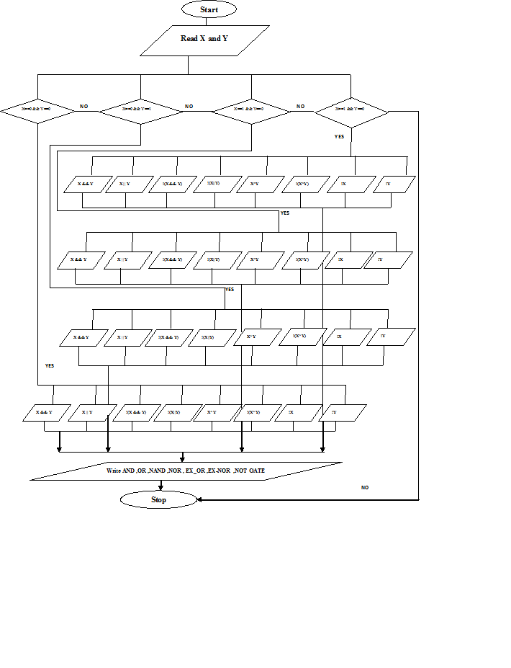

Slide 12
Topics that it (project) will cover
For this projects function:
It needs integer data types.
It needs one “While Loop” condition.
Under the “While Loop” condition it will be need to declare “Pointer files for individual (AND, OR, NAND, NOR, EX_OR, EX_NOR, NOT) logic gates for showing output in individual output files.
Under the “While Loop” if else conditions will be needed to apply for individual (AND, OR, NAND, NOR, EX_OR, EX_NOR, NOT) logic gates condition for it.
After applying condition, pointer files have to close.

Slide 13
WORKING PROCEDURE

Slide 14
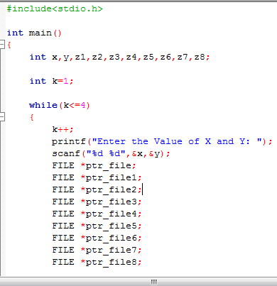
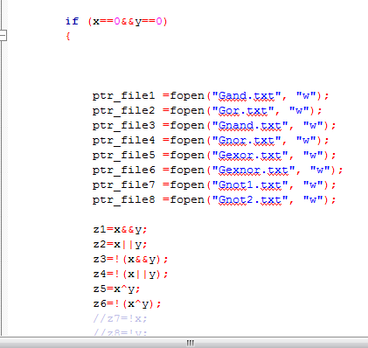

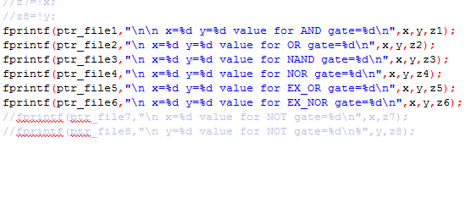

Slide 15
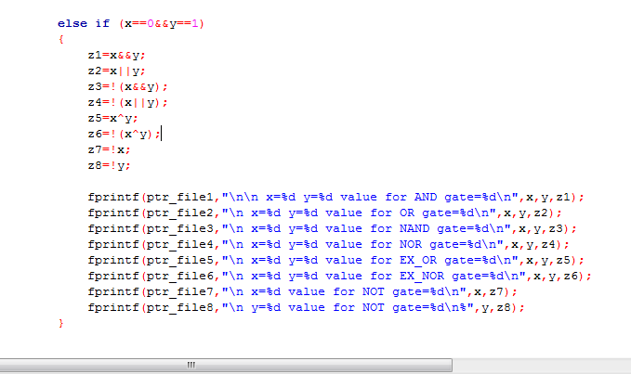
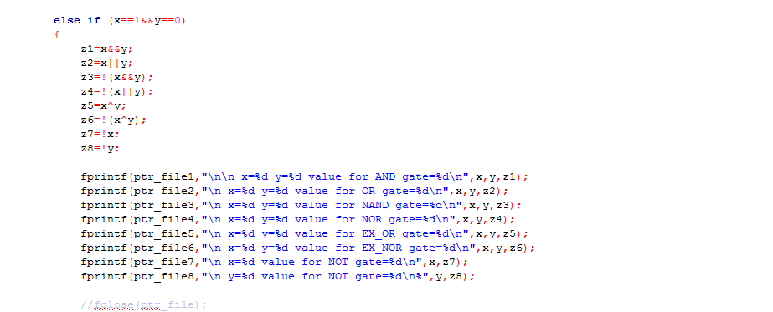

Slide 16
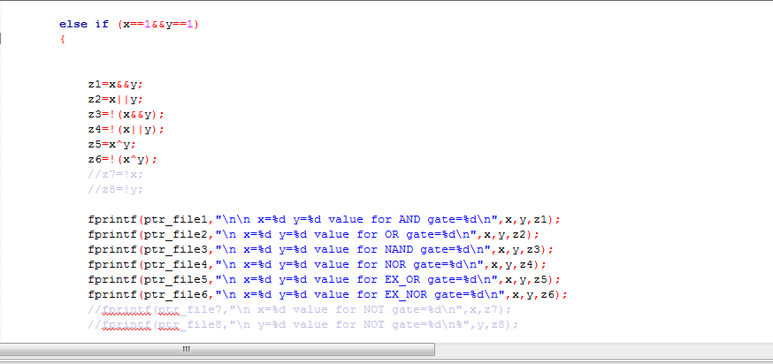
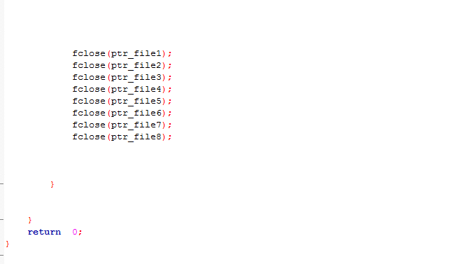

Slide 17
AFTER BUILD AND RUN

Slide 18
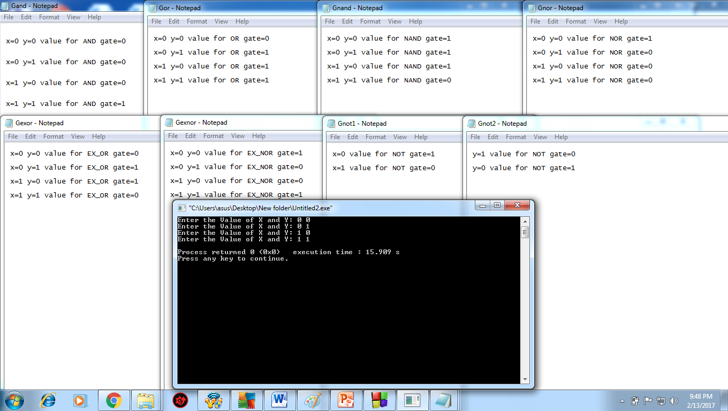

Slide 19



